Slide 1


Slide 2

SIGNIFICANCE…
I can't stop the wars
Shelter homeless, feed the poor
I can't walk on water
I can't save your sons and daughters
Well, I can't change the world and make things fair
The least that I can do
The least that I can do
The least that I can do is care

Slide 3

Employability Skills
Pre-Engineering &
Computer-Aided Design
MR. MANDL
GOAL SETTING

Slide 4

GOALS…
What is a goal?
  Something you would like to achieve
What is the purpose of setting goals?
  Give you direction
  Keep you focused on where you want to end up

Slide 5

IN YOUR NOTES…
What are some things you hope to achieve in the next few weeks or months?
What are some things you hope to achieve in the next few years?

Slide 6
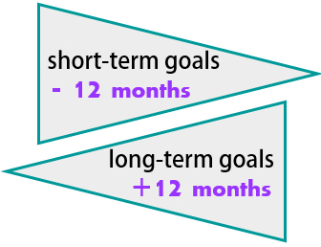
TYPES OF GOALS
Short-Term:
  Goals that can be accomplished in the near future (within a few weeks or months)
Long-Term:
  Goals that are more far-reaching
  Take longer to achieve
  (a year or more)

Slide 7
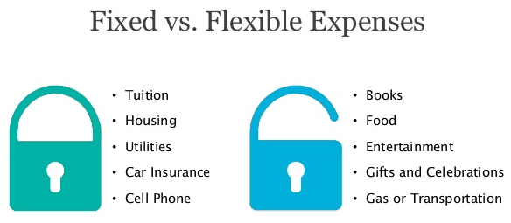
TYPES OF GOALS
Fixed:
  Goals with an outcome based on a specific date and / or time
Flexible:
  Goals that have an outcome, but no set time limit

Slide 8
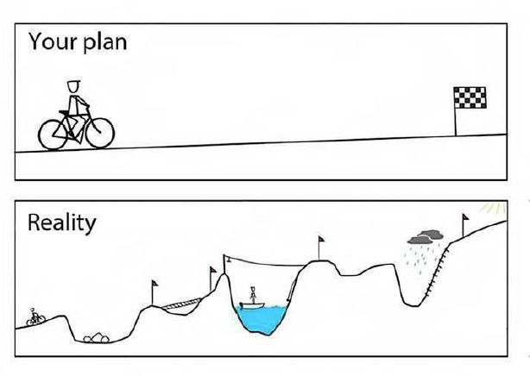
IN YOUR NOTES…
List an example of each of these types of goals:
  Short-Term
  Long-Term
  Fixed
  Flexible

Slide 9

SMART GOALS
S = Specific
M = Measurable
A = Achievable
R = Relevant
T = Time-Bound

Slide 10

CREATING SMART GOALS
Specific
  Goals should have expected outcomes stated as simply and clearly as possible
Measurable
  Include a way to know how you will know if you have met your goal

Slide 11
CREATING SMART GOALS
Achievable
  Goals should have outcomes that are realistic given your current situation, resources, and available time
Relevant
  Goals should help you on your journey toward meeting larger, ultimate life outcomes
Time-bound
  Goals should include realistic timeframes for achievement

Slide 12

REALISTIC vs. UNREALISTIC GOALS
Setting unrealistic goals can lead to feelings of failure, lowered self-image, and lowered self-esteem
What makes goals unrealistic?
  Untimely
  Requiring unavailable resources
  Written in vague terms or terms that are too general

Slide 13

NO CAREER GOALS YET?
Set goals for academic achievement
Set goals for volunteering
Set goals for researching different types of careers
Set goals for building skills and abilities
Set goals for earning and saving money

Slide 14

WHAT IS A CAREER PLAN?
A map that can show you a way to reach your career goals
  First, write a statement describing your ultimate career goal
  I will be an Occupational Physical Therapist in Colorado by the time I am 30 years old.

Slide 15

WHAT IS A CAREER PLAN?
Add short-term career goals
  Include a timeline, for example:
    1. Get an “A” in health class this semester
    2. Volunteer at a physical rehabilitation center
    3. Research Colleges and Universities that offer
    physical therapy degrees by the end of this year

Slide 16

KEEP IN MIND…
Be Flexible!
  Goals and/or resources can change so remain flexible and be ready to implement your back-up plans…
    “B”
    “C”
    “D”

Slide 17
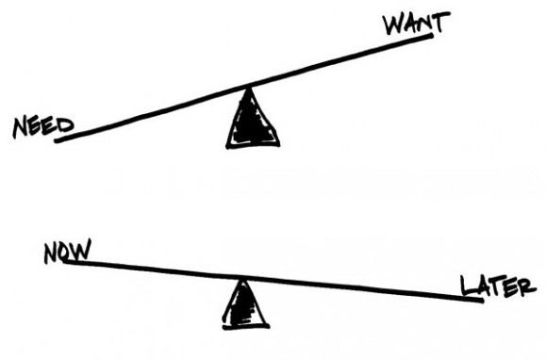
KEEP IN MIND…
Trade-offs…
  Sacrifices
    Giving up one thing to get something else
  Focus on things that are most important
  Create your own opportunities

Slide 18
YOUR ULTIMATE GOAL
Success and happiness

